Slide 1
Nonprofit & Human Service
Program Overview

Slide 2




WE ARE GUIDEONE:
71 years and 625 people strong.
We are fiercely committed, now more than ever, to helping our customers achieve their mission of serving others.
50,000
policyholders
3,000
independent agents
nationwide
$500M+
in written premium
Specialists in
Religious Organizations, Nonprofits, Education and Small Businesses
Highly Rated Claim Service
Notes:
Rob

Slide 3
GuideOne'S nonprofit & Human Services Appetite
GuideOne insures a variety of nonprofits and nonprofit human services organizations that strengthen their communities by serving those who need their help and support.
Aging | Behavioral (Includes Mental Health & Substance Abuse) | Community Services | Developmentally Disabled | Youth
Senior Centers | Outpatient Programs | Arts, Culture, Museums | Group Homes In Home Care | Group Homes In Home Care
Meals on Wheels | Transitional Living | Adult Ed. Shelters | Sheltered Workshops | Boys & Girls Clubs
Adult Daycare | Residential Facilities | Thrift Stores Food Banks | Vocational Programs | K-12 Charter or Private School.
 | In Home Services | Pregnancy Centers | Independent Living | CASA Head Start
WC ONLY—Senior Living |  | Advocacy Many More | Recreation Respite | And More…

Slide 4
Out of Appetite
+ Adoption or Foster Services/Placement
+ Affordable Housing less than 25% of TIV (no housing subject to HUD Inspection)
+ Animal Rescue or Humane Societies
+ Commercial Lending, Insurance or Financial Management
+ Community Redevelopment
+ Construction (new homes) or Property Repair for others
+ Disaster Relief as primary focus (includes both US & International)
+ For-Profit Organizations
+ Hospice or Senior Home Healthcare
+ Human Trafficking Shelters &/or Crisis
+ International Operations unless incidental or ancillary operations
+ Juvenile Justice Programs
+ Legal Aid/Services
+ 100% Para-Transit
+ Public Medical Clinics (FTCA)
+ Residential Facilities for Violent or Sexual Offenders
+ Senior Nursing Homes, Senior Assisted Living, Senior Independent Living EXCEPT WC $100k+
+ Youth One-on-One Mentoring (acceptable if done within community setting)

Slide 5
Nonprofit & Human services Coverage & More…..

Slide 6
Lines of business Offerings
Package (Property, IM, Crime, GL, D&O, EPL, PL, Abuse)
Auto (monoline auto is not available)
Umbrella (up to $10M limits)
Workers Compensation
Directors & Officers and Employment Practices Liability (must be written with the GL – not available standalone)

Slide 7
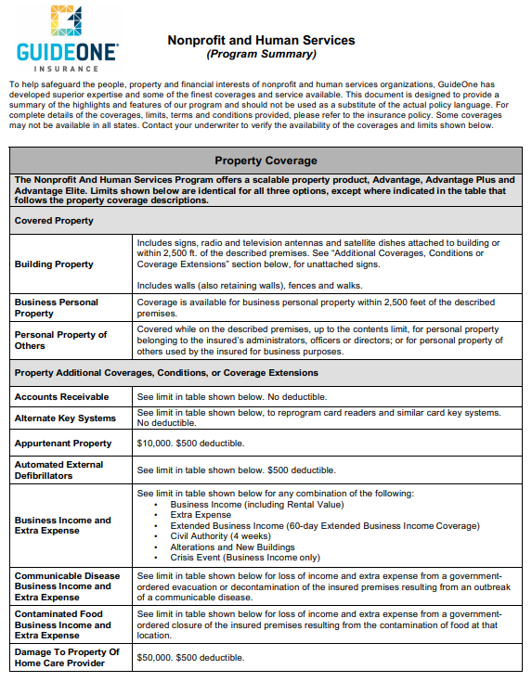
Property Overview
Property Enhancement has 3 levels of coverage options:
  Advantage
  Advantage Plus
  Advantage Elite
52 coverages, robust offering and flexibility for both small, moderate and larger accts
Full comparison provided in the Program Summary (let’s review).
ISO Property with full capabilities
Key Person Replacement is optional
Notes:
At this point we will handout the Program Summary and review as a group.

Slide 8
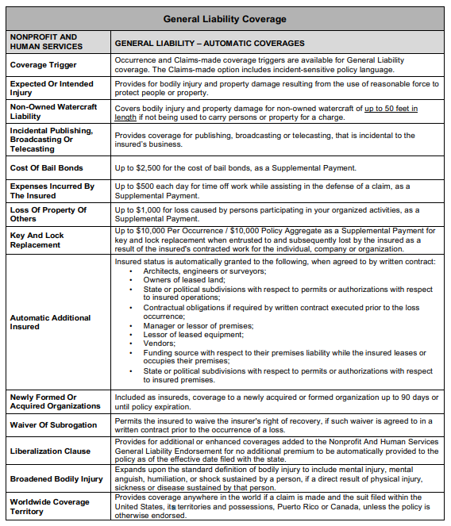
GL Overview
ISO GL with proprietary GL Endorsement
GuideOne NP HS GL Endorsement
  AI’s
  Waiver of Subrogation
  Key & Lock Replacement
  Incidental Publishing, Broadcasting or Telecasting
  Damage to Property of Others $1000
  Exclusion for Abuse, PL & Special Events (we will add back with blanket or schedule form)
Additional GL Forms:
  Crisis Management
  Fellow Employee
  Blanket Special Events
  Employee Defense
Notes:
At this point we will handout the Program Summary and review as a group.

Slide 9
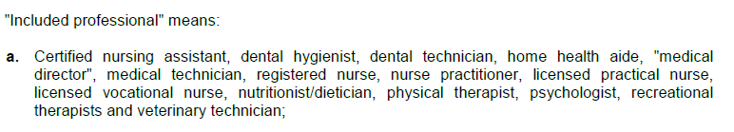
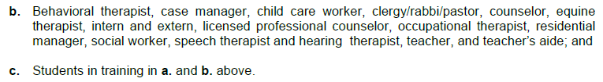
Human Services Professional Liability
Human Services Professional Liability (HS) is our new PL coverage form
  Covers both individual professionals and vicarious liability for the entity
  Includes “Damages” arising out of rendering or failure to render services
  Many professionals included:
  Available for new business in AL, AZ, CT, GA, IA, IN, KS, LA, MI, MN, MO, MS, NC, NJ, OH, PA, SC & TN and more states are coming soon!
  We will convert policies as they renew (discuss)

Slide 10
Human Services Professional Liability (HS)
Highlights of our new form:
  Flexibility to craft custom coverage to add specific professionals or carve out coverage depending on situation
  Deductible options available
  Occurrence or Claims Made
  Defense outside the limits
  Separate limits from GL
  Vicarious liability included for contracted professionals when underlying med mal in place for $1m (Doctors, Psychiatrists, Dentists, etc.)
  Ability to offer PL on an incidental basis for nominal charge
  “Medical Director” covered automatically even with some incidental medical duties:
  “A medical director may, from time to time, perform incidental, ancillary, and non-invasive medical services as part of their regular duties for you.”

Slide 11
Sexual Misconduct Liability Coverage
Available on either Occurrence or Claims-Made basis
Separate limits from GL & PL
Same form used for all of our niches
Coverage allows for payment of medical bills and counseling expenses on a no-fault basis which may result in a quicker resolution of claim
  Medical Payment limit is $10,000 per sexual misconduct occurrence, as defined in the policy
  These limits are outside of SM limits at no additional charge
Additional Endorsements Available:
  Abuse Coverage Endorsement (GCG 74 01)
  Alleged Perpetrator Civil Defense Coverage Endorsement $25,000 (GCG 74 27)

Slide 12
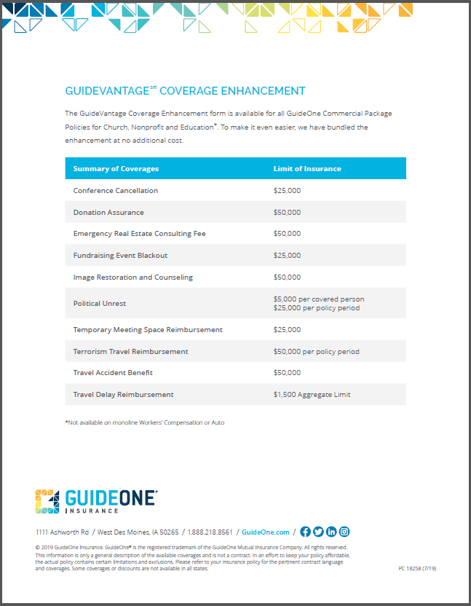
GuideVantage^{sm} Coverage Enhancement
What does this apply to?
  Applies to NP, Church and Education niches
  Applies when CPP or a component of CPP (Property or GL) is written
  Not available for monoline WC or auto
Includes 10 coverages with many appealing to board members
No additional premium and automatically applied on NB and renewals as it becomes filed/available

Slide 13
GuideVantage^{sm} Coverage Enhancement
Additional Coverage | Limits of Insurance
Conference Cancellation | $25,000
Donation Assurance | $50,000
Emergency Real Estate Consulting Fee | $50,000
Fundraising Event Blackout | $25,000
Image Restoration and Counseling | $50,000
Political Unrest | $5,000 per covered person $25,000 per policy period
Temporary Meeting Space Reimbursement | $25,000
Terrorism Travel Reimbursement | $50,000
Travel Accident Benefit | $50,000
Travel Day Reimbursement | $1,500

Slide 14
GuideVantage^{sm} Auto Enhancement
Available for ALL niches
A premium charge will apply
  3% of the total Business Auto premium
  Minimum premium - $200
Available to any size account where owned or leased vehicles are scheduled
  We will recommend adding to fleet sizes of 5 or more autos
Our additional coverages and limits include:
  Liability Coverage Extensions
  Physical Damage Coverage Extensions
  Business Auto Conditions
This Coverage Enhancement Endorsement can be added to all niches!

Slide 15
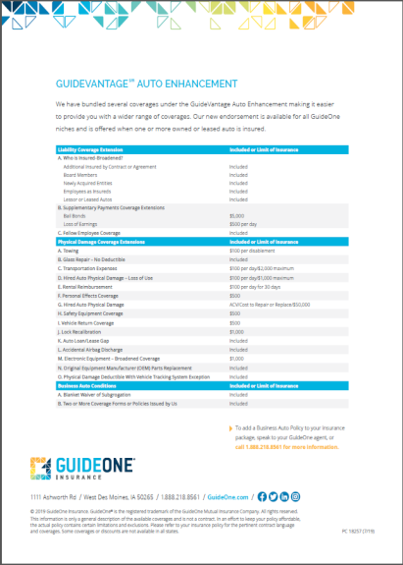

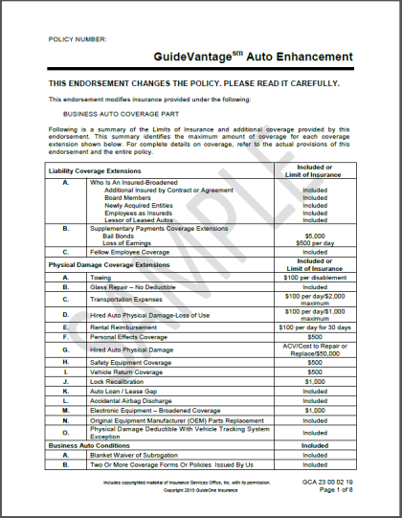
GuideVantage^{sm} Auto Enhancement
Copies of the coverage form and sales flyers can be found on GuideLink!

Slide 16
New Business Submission Requirements
Acords forms – MUST INCLUDE FEIN#
Supplements - either GuideOne or competitors New Business suppl app (not renewal supps)
5 year Loss Runs (can quote subject to)
Send submissions to: commercial@guideone.com
Need by date and any expiring or target premiums

Slide 17



The GuideVantage
More than insurance
We offer our customers GuideVantage, a host of exclusive, complimentary value-added resources. The GuideVantage services and programs are free or significantly discounted and offer highly specialized expertise in areas including:
Human resource solutions and complimentary HR training tools.
Employment screening and background check services.
Free risk management resources such as webinars, articles, and fact sheets.
Armed intruder resources focused on awareness, education and training.
Innovative and proactive risk management options like Roost Smart Water Leak and Freeze Detectors

Slide 18
ACCREDITATION
CARF International (CARF) http://carf.org/home/ (Commission on Accreditation of Rehabilitation Facilities) Service areas include: Aging, Behavioral Health, Child/Youth Services, Employment/Community Services (including vision rehab), Medical Rehab & Opioid Programs Accredits more than 59,000 programs, more than 50 years in business and extends internationally Click “Find a Provider” to find accredited orgs. or do advanced search to get lists by zip code, state, city, program, etc. The Joint Commission (JCAHO) https://www.jointcommission.org/ (Joint Commission on the Accreditation of Healthcare Orgs) Accredits nearly 21,000 healthcare organizations in the U.S. and you can search for accredited organization on their website by name, service, state, city or zip code. Service areas are numerous related to healthcare, but for Human Services, we will see Behavioral Health Care organizations that have The Joint Commission accreditation. The other accreditations they do are out of our appetite. Council on Accreditation (COA) http://coanet.org/home/ Accredits the full continuum of child welfare, behavioral health, and community-based social services. Accredit more than 2,200 organizations with separate programs for private organizations, public agencies, Canadian organizations, military family readiness programs, child and youth development programs and international adoption programs. Link to search here: http://coanet.org/accreditation/who-is-accredited/who-is-accredited-search/ The Council on Quality and Leadership (CQL) https://www.c-q-l.org/ Provides accreditation, training, certification, research and customized consultation services to organizations and systems. Their accreditation targets human service organizations serving people with intellectual and developmental disabilities, mental health diagnoses, older adults and children/youth. Link to search here: https://c-q-l.org/accreditation/currently-accredited-organizations

Slide 19
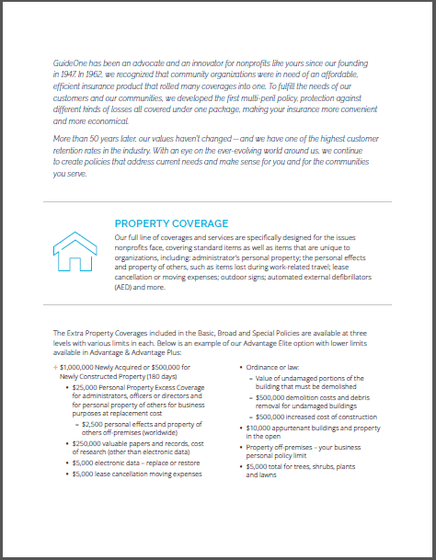


New Nonprofit Brochure

Slide 20
Questions?
Thank you

